Slide 1
Draw cell
Nguyen Phan Xuan Truong
https://github.com/svalvaro/drawCell

Slide 2
Content
Some principles to design
Drawcell package
Power Point

Slide 3
drawCell
The goal of drawCell is to easily obtain nice cell pictures in R!
remotes::install_github("rstudio/webshot2")
install.packages("devtools")
devtools::install_github("svalvaro/drawCell")
library(drawCell)

Slide 4
drawCell
It requires the taxonomy id of your species of interest, and one or multiple SL codes for subcellular locations that will be colored. The SL codes for each subcellular location can be found at Uniprot and uniprotkb_sl2go.
taxonomy id: https://www.ncbi.nlm.nih.gov/taxonomy/
SL codes for each subcellular location: https://www.uniprot.org/docs/subcell
http://current.geneontology.org/ontology/external2go/uniprotkb_sl2go

Slide 5
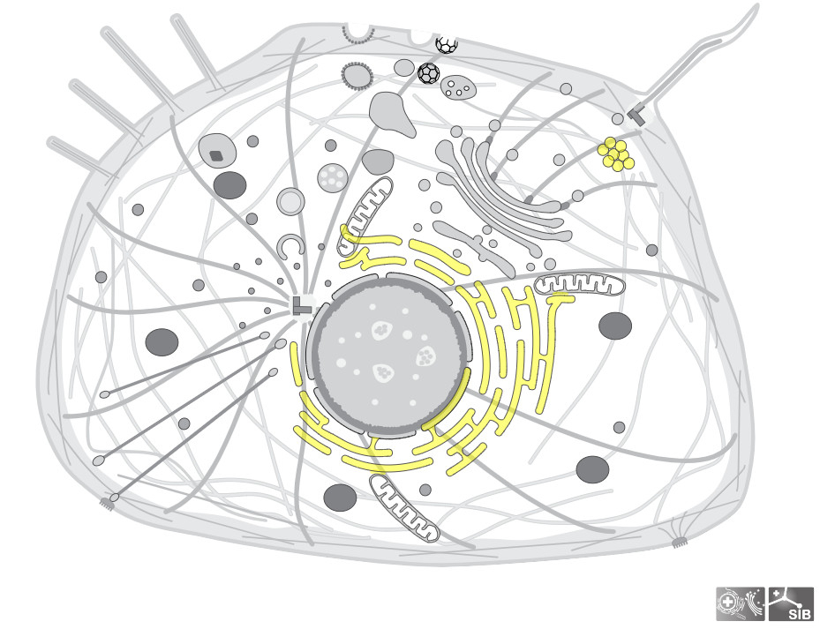
Example1
To generate a cell of Homo sapiens (Taxonomy id: 9606) with highlighted Endoplasmic Reticulum (SL code: 0095) and lipid droplets (SL code: 0154):
drawCell(organism_identifier = '9606', sl_ids = c('0095','0154'), color = 'yellow')

Slide 6
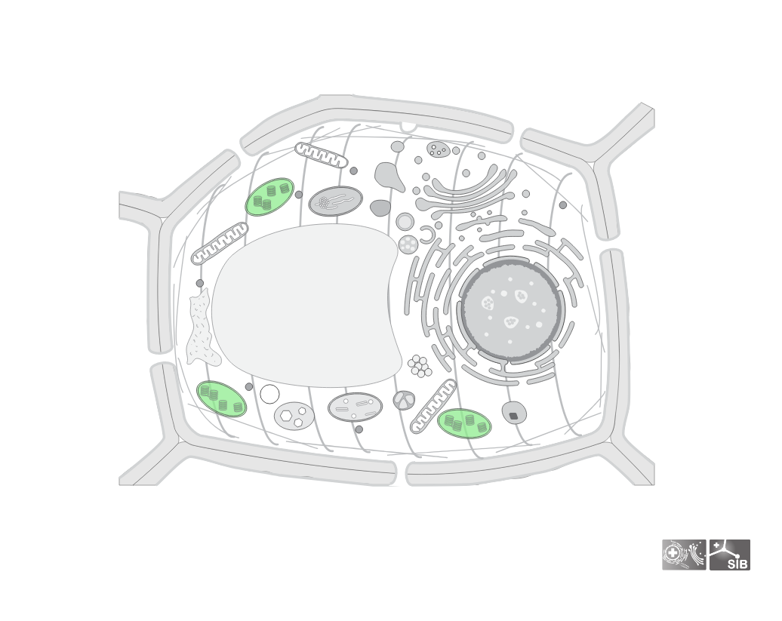
Example2
The taxonomy id for Quercus ilex a common tree in the south of Spain is 58334 and as an example I will use the SL code of the chloroplast: 0049.
drawCell(organism_identifier = '58334', sl_ids = '0049', color = 'lightgreen')

Slide 7
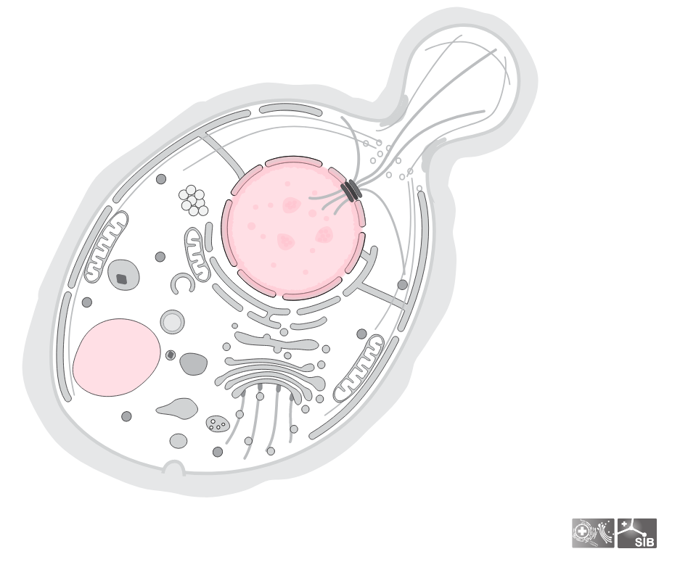
Example3
For the baker’s yeast Saccharomyces cerevisiae whose taxonomy id is 4932 we will highlight the nucleus: 0191 and the vacuole: 0272.
drawCell(organism_identifier = '4932', sl_ids = c('0191', '0272'), color = 'pink')
We can also obtain pictures of viruses, yeast, and pretty much everything that exists!

Slide 8

Procreate

Slide 9

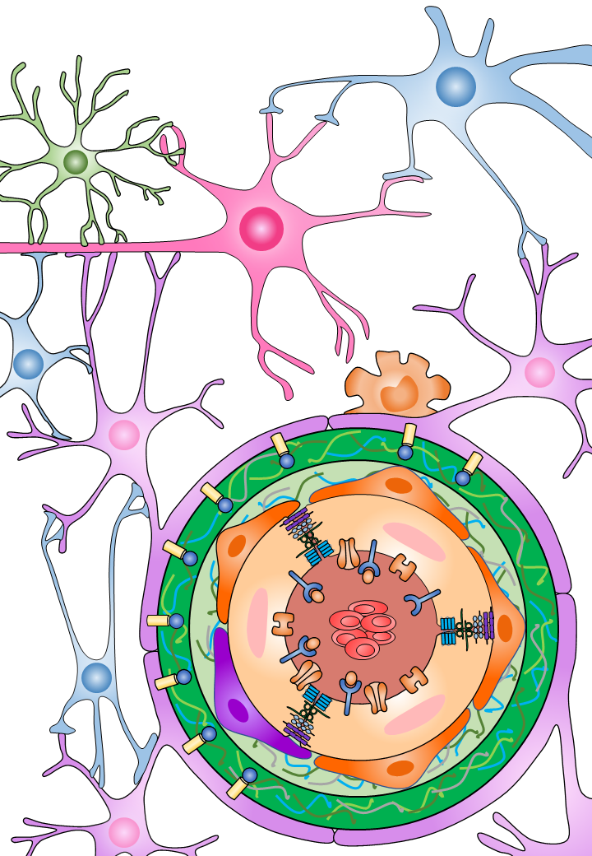
Power Point

